Slide 1
LG BOOST

Slide 2
Light Gradient Boosting Algorithm
Handles huge amount of data well
Poor in small dataset
It uses histogram –based method for selecting best fit
For Continuous values splits up into bins (or) buckets

Slide 3
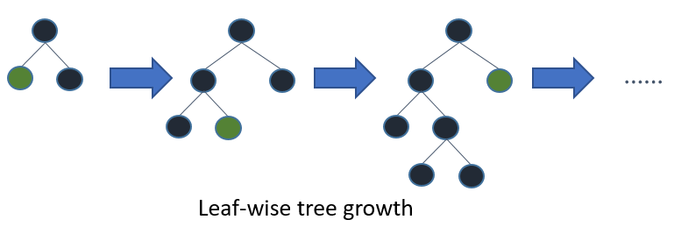

Slide 4
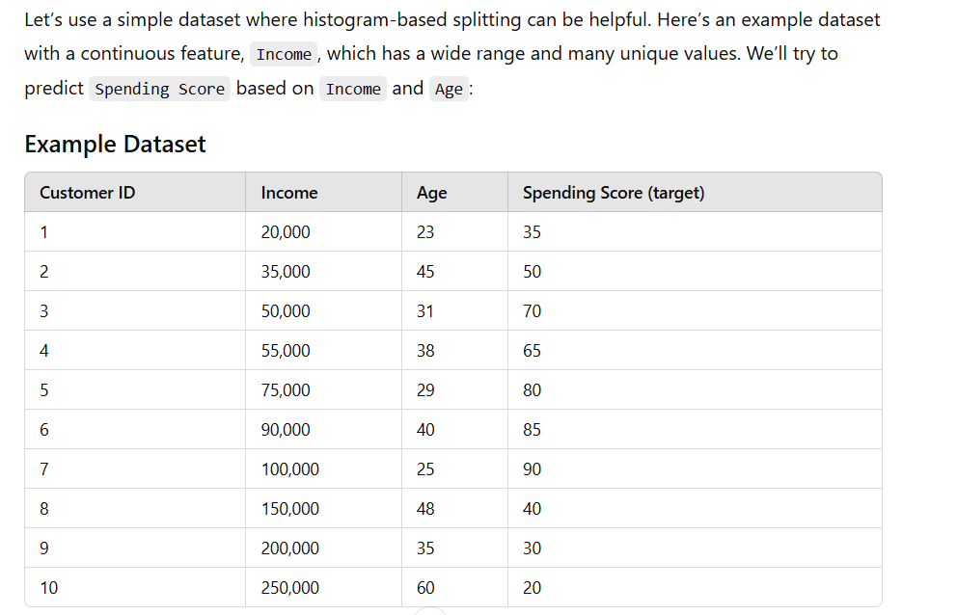
Example

Slide 5

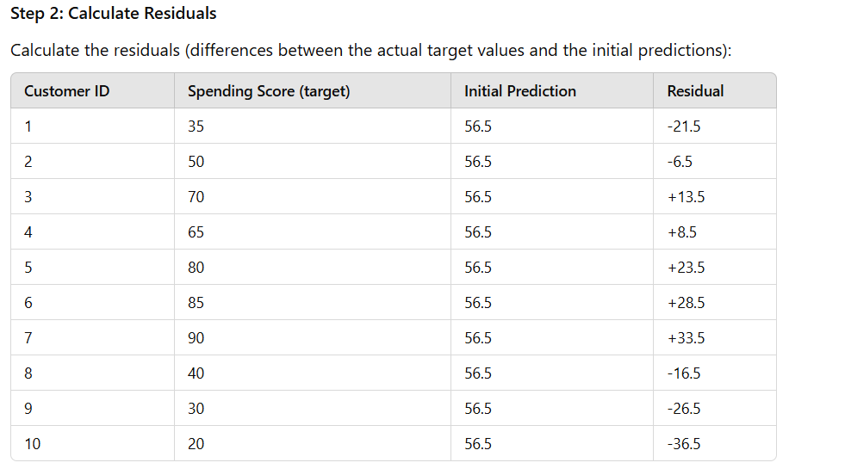

Slide 6
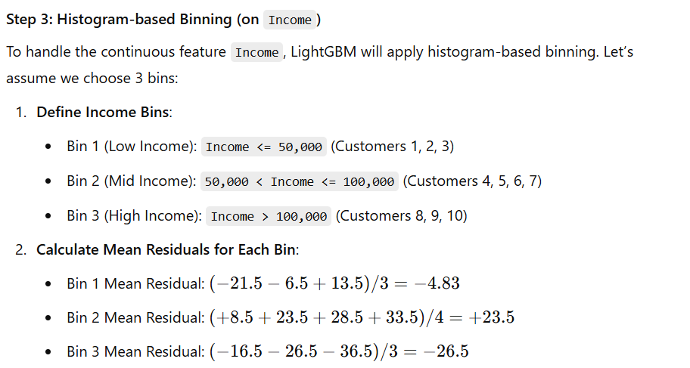

Slide 7
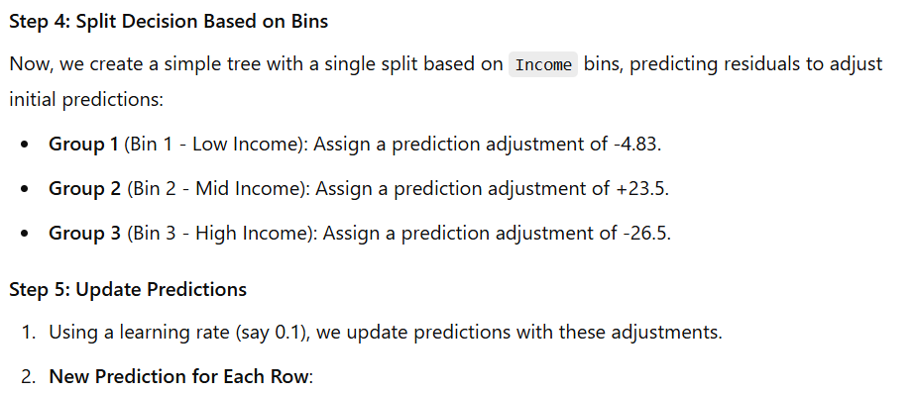

Slide 8
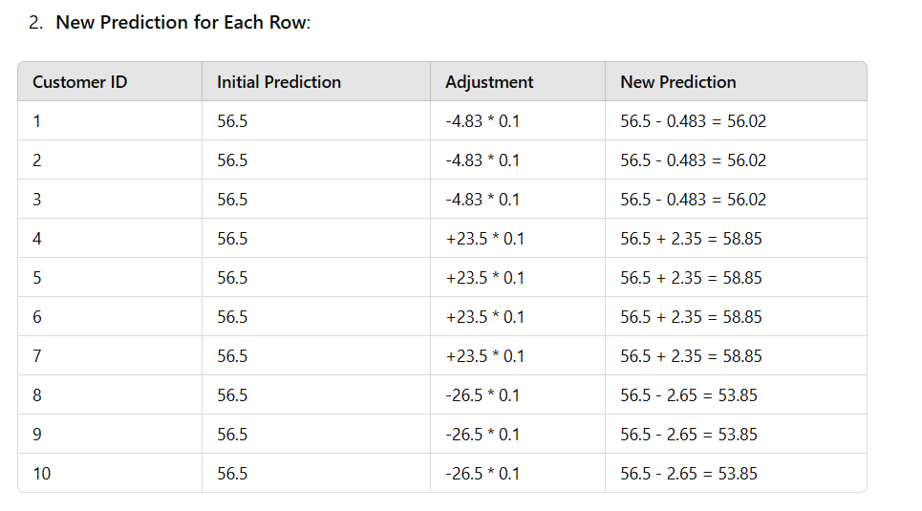

Slide 9
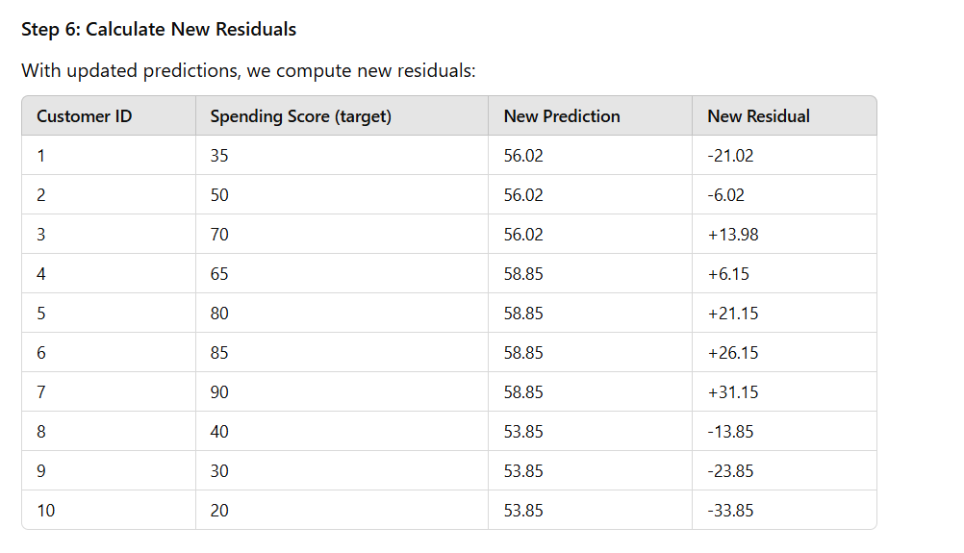

Slide 10


Slide 11


Slide 12
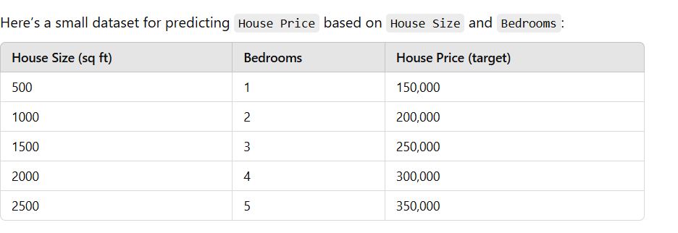
Example for leaf wise growth

Slide 13


Slide 14
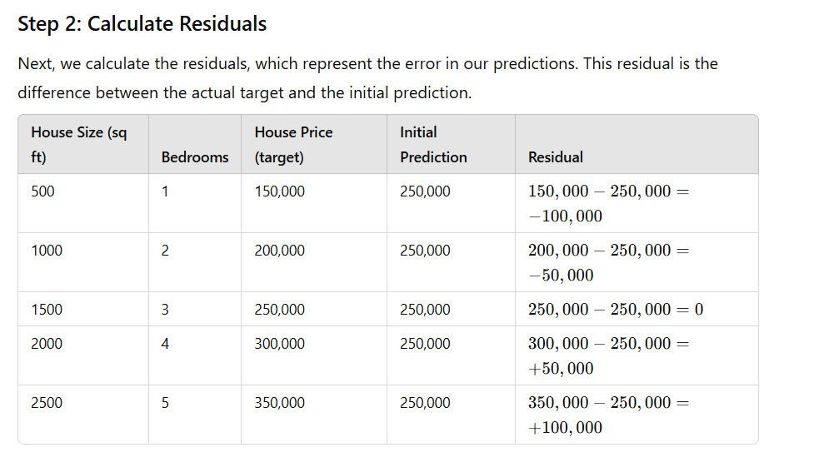

Slide 15
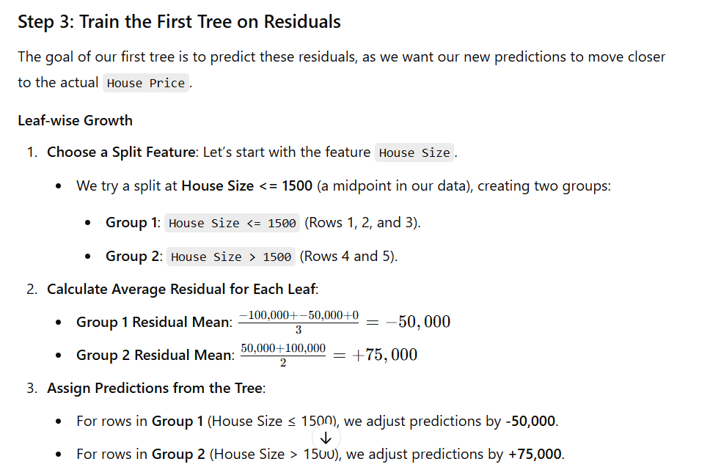

Slide 16
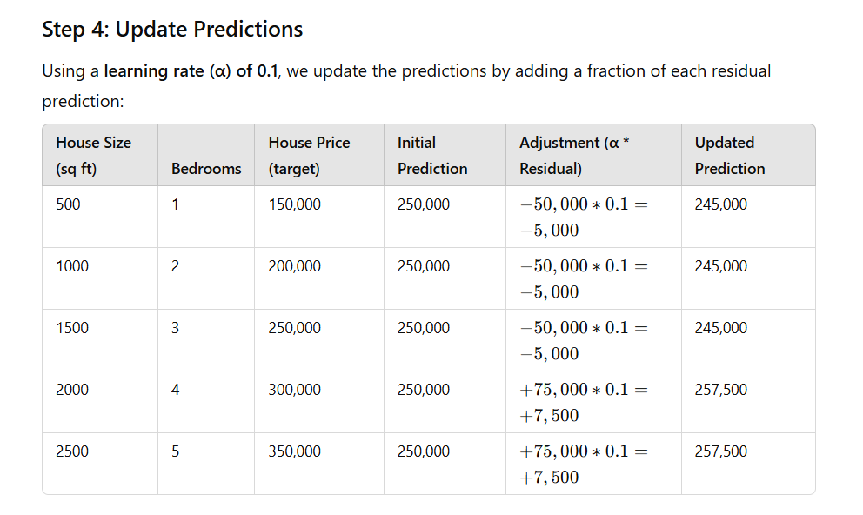

Slide 17
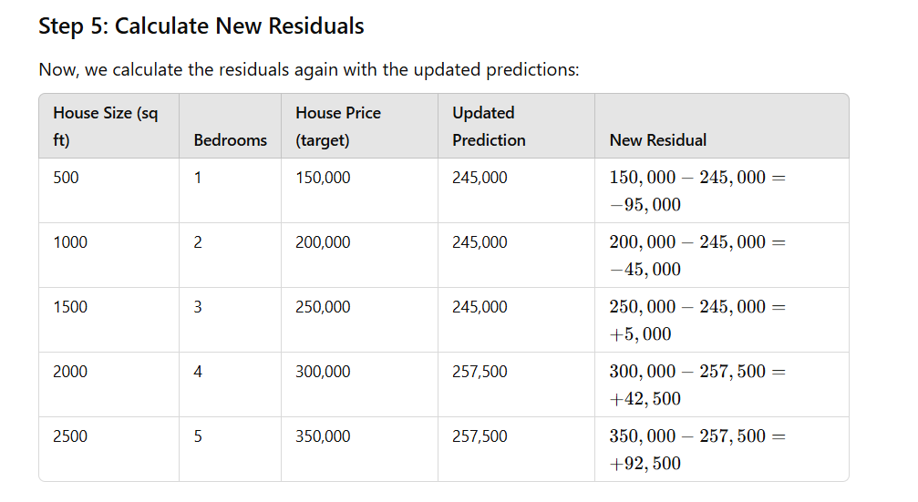

Slide 18


